Slide 1

AI Analyst Personas: Mitigating Bias in creating Personas
Organizations struggle to incorporate diverse perspectives into decision-making, especially with AI. Our solution leverages Watsonx.ai to create structured AI analyst personas. These personas ensure comprehensive, unbiased approaches to research and policy.
by Team Agentic Explorers

Slide 2
The Challenge: Overlooked Perspectives
The Problem
Our Solution
This AI-enabled solution using Agentic framework, tries to solve this problem using state of the art AI technology as well as human in the loop. The solution leverages Watsonx.ai, LangGraph, Langchain and Opensource Granite-3-8b-instruct model
Without structured personas, biases emerge, and critical viewpoints are missed. This impacts data governance, policy, and compliance.
Current Solution
New roles like "Persona Architect“,
”Persona Designer” are emerging to tackle this.

Slide 3

Massive Market Opportunity
$1.81T
$3.59B
Global AI Market by 2030
AI Governance Market by 2033
CAGR of 35.9% from 2025-2030. Source
Indicates emphasis on AI governance. Source
20.86%
AI Consulting CAGR
Projected from 2025-2034, reaching $58.19B. Source

Slide 4





Key Advantages of Our Approach
Scalability & Automation
Bias Reduction & Diversity
Automates persona generation, saving time and costs compared to manual methods.
Ensures diverse viewpoints, reducing biases in decision-making for AI governance.
AI Customization with Open Source
Enterprise Integration
Iterative persona refinement based on user feedback, unlike rigid chatbot systems with state-of-the-art IBM’s opensource models and technology
Integrates into AI governance tools or sold as SaaS to consulting firms.

Slide 5



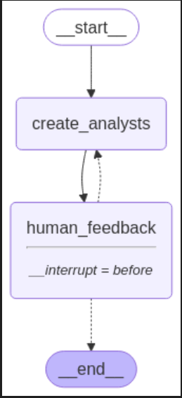


How It Works: A Simple Workflow
User Input
Input a research topic and provide editorial feedback.
AI Generation
AI generates analyst personas with structured attributes.
Refinement
Refine personas based on user feedback.
AI-Driven Advisors
Use refined personas for research, policy, and decisions.

Slide 6
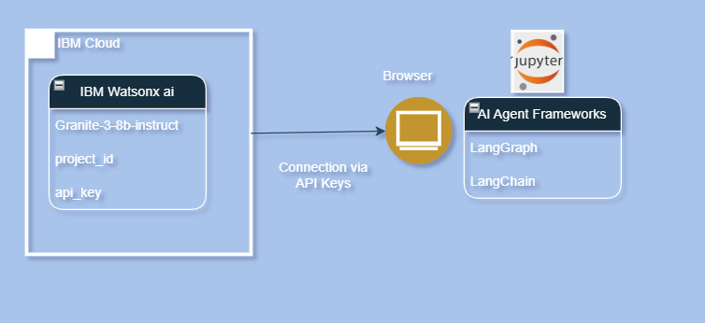
Technology: Watsonx.ai, LangGraph, Granite-3-8b-Instruct
AI-Powered Persona Generation
User Feedback Integration
NLP
Analyzes research topics to determine themes and stakeholder roles.
Constructs personas with affiliation, role, and thematic focus.
Iteratively refines personas based on user guidance.
Leveraging a LangGraph-based workflow, our AI efficiently generates personas. Real-time adjustments enhance accuracy and relevance. We are using Watsonx ai platform and Granite-3-8b-instruct model which we found giving good results, without any further finetuning or prompt engineering

Slide 7

Future Roadmap & Monetization
Pilot & Partner
Integrate Knowledge
Partner with AI governance teams and consulting firms.
Develop UI
Enhance personas with real-time reports and trends.
Expand Personas
Build a web-based UI for intuitive user interaction.
Introduce personas across finance, healthcare, and legal sectors.

Slide 8

Conclusion: The Future of AI Governance
Our project ensures diverse, well-structured perspectives. Leveraging IBM watsonx.ai enhances AI's ability to create virtual analyst personas.
Our solution is unique, scalable, and applicable across industries. It offers real-world potential for business adoption.

